Slide 1
Know How To Strengthen Your Dell Inspiron
1525 Battery Life

Slide 2
Dell Support Number-1-800-921-785
The laptop producers claim their product to be the best but still these products are not perfect as the users can find fault with it. To make Dell Inspiron battery 1525 give the optimum output one has to make sure that they are taking the right steps for it. The laptop producers at times manipulate the reality and present it in a very different manner. The users can often be mistaken by the face value of the laptops and can be tempted to buy it

Slide 3
The customers can follow the steps like :-

Slide 4
Choose de-fragmentation---- Frequent de-fragmentation is good for making your laptop battery keep going longer. What it does is that it allows the computer to bring forth the accessible information properly as the hard-disk takes a minimal amount of time for obtaining the details. As quick as the hard disk operates it puts lower stain on the battery which helps it keeps going longer and longer.

Slide 5
following this procedure if you are facing any technical issue you can any time call Dell support
Australia 1-800-921-785

Slide 6
The operators can prevent abandoning CD/DVD in hard drives when not utilizing them. The spinning disk helps in driving away piping Dell laptop battery hence decreasing its life.
Stop the schedule assignments whether its de-fragmentation or computer virus checking. Ensure that the users plans it for a particular period of time.
Keep the external gadget disconnected. If the operators disconnects external audio system, external computer mouse, Bluetooth or perhaps the connected IPOD. The electric batteries will work much better and therefore he or she does not have the need to connect them.
He or she needs to set the minimum level of Dell laptop display screen light. This may take off the lots of strain from the electric batteries.
Always minimize the volume and usage of computer multimedia software. Prevent the utilization if not necessary. The operator can silence the sound system if not listening. This can lead to a longer life of battery.

Slide 7
He or she can favour the hibernation settings more than stand by settings. At all times choose hibernation settings.
The customers can prevent utilizing a couple of programs at any given time. Using lots of programs at a time can fizzle the battery of 1525 Dell inspiron
Choose extra RAM. He or she can make use of sufficient RAM to reduce the strength.
The operators must make use of original adaptors. As using an adaptor one has to make sure that it an original item. In other circumstances it may take more battery consumption.

Slide 8
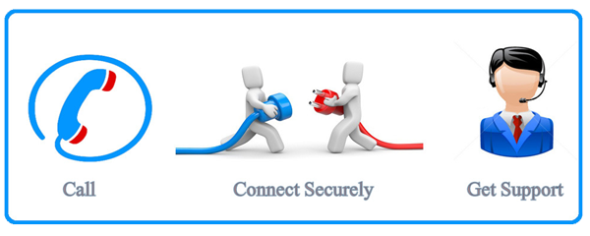
These are the steps one needs to take stop
the battery from excessive consumption.
Otherwise the customers can call the
customer support number 1-800-921-785 and get help. The technical experts are talented
and can provide help to the customer every time.

Slide 9
For any technical support you can any time contact Dell helpline number Australia
1-800-921-785
Original Source

